Slide 1

Java Futures
Short introduction
© Natallia Müller, ING Germany

Slide 2
Java Future
Java Future is an interface used to represent the result of asynchronous computation
Exists since Java 5
Comes from java.util.concurrent package
You need an ExecutorService to use the Future, it provides the threads pool and assign the tasks to the threads
The task being executed should implement Callable interface

Slide 3
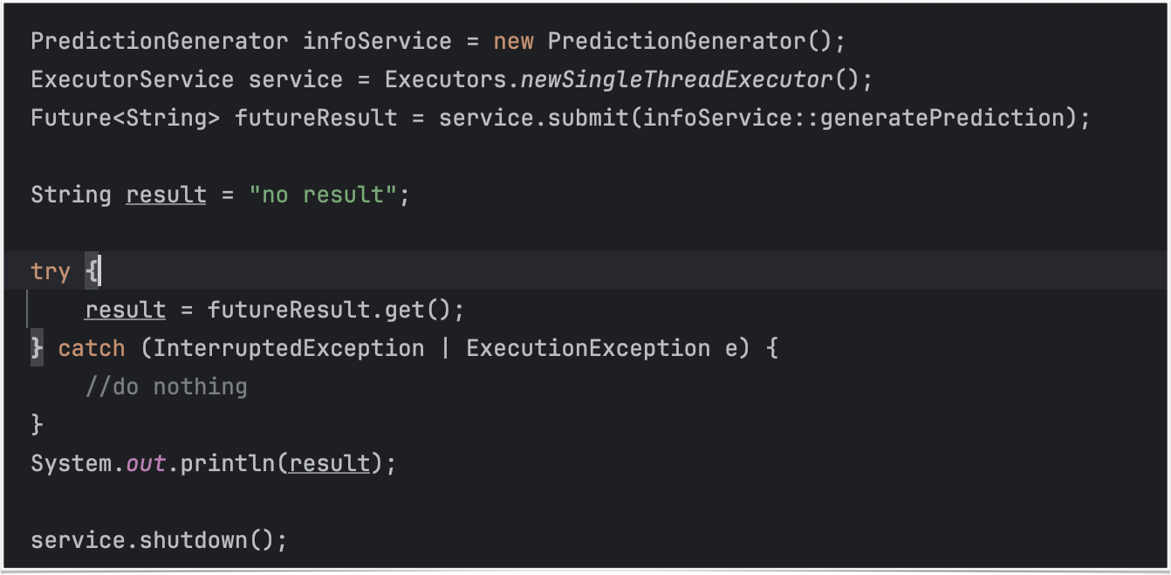
Java Future

Slide 4
Executor / Callable
Callable interface exposes a single method, returning a single value
Similar to Runnable, but returns a value in form of Future
Executor is an object, that executes submitted runnable tasks
ExecutorService provides a pool of threads for execution of the tasks
Tasks for execution are submitted via submit()

Slide 5
Pull solution
To get the result of the Future, the method get() can be called.
This blocks the thread until the result can be asynchronously calculated
In failed case, an ExecutionException will be thrown.
Limits:
By lots of tasks lots of thirds are needed, which are waiting for execution -> very resource intensive!!! -> limited for scaling

Slide 6
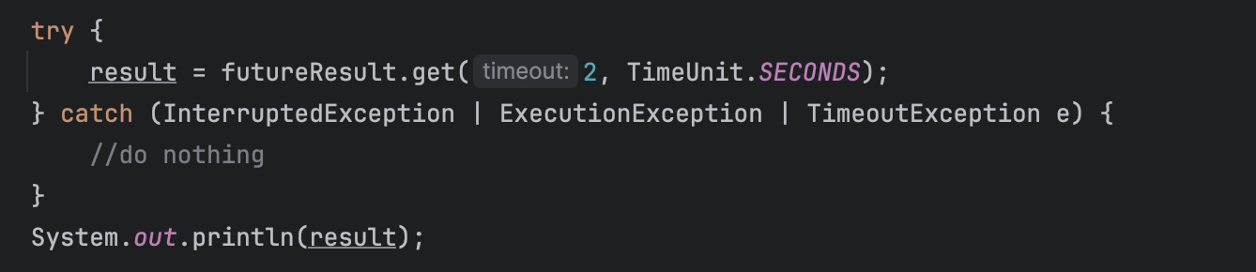
Poll solution
Use overloaded get()-method
V get(long timeout, TimeUnit unit) throws InterruptedException, ExecutionException, TimeoutException;
After timeout has been reached, the method throws the TimeoutException and informs, that the result is still not available
Limits: CPU resources for polling

Slide 7
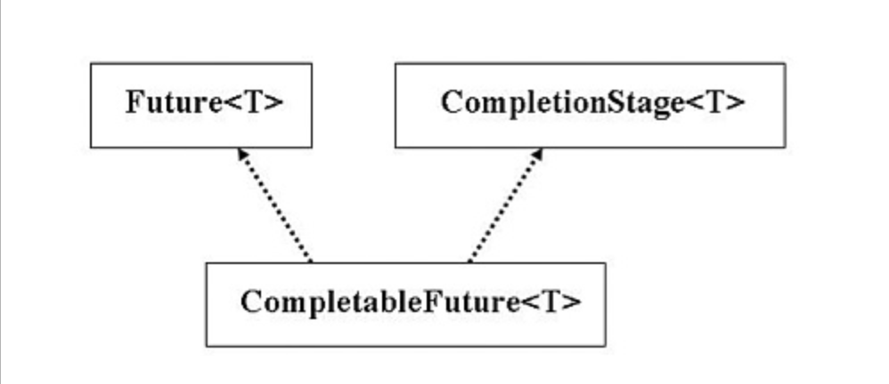
CompletableFuture
Since Java 8
Asynchronous, non-blocking tool
Allows to write the code in more responsive and efficient way

Slide 8
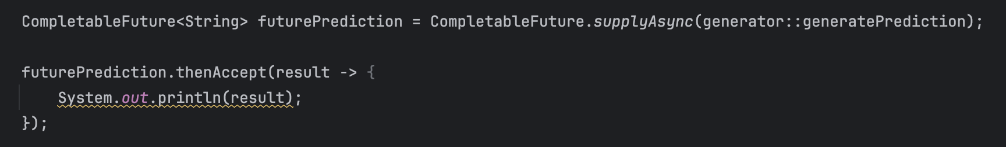
CompletableFuture
The method thenAccept() contains the future result, which can be used for further operations (in example print the prediction)
The lambda-expression will be triggered as soon as the asynchron result is delivered
The threads is not blocked and runs independently on the availability of the result
In error case nothing will happen (no exception is thrown)

Slide 9
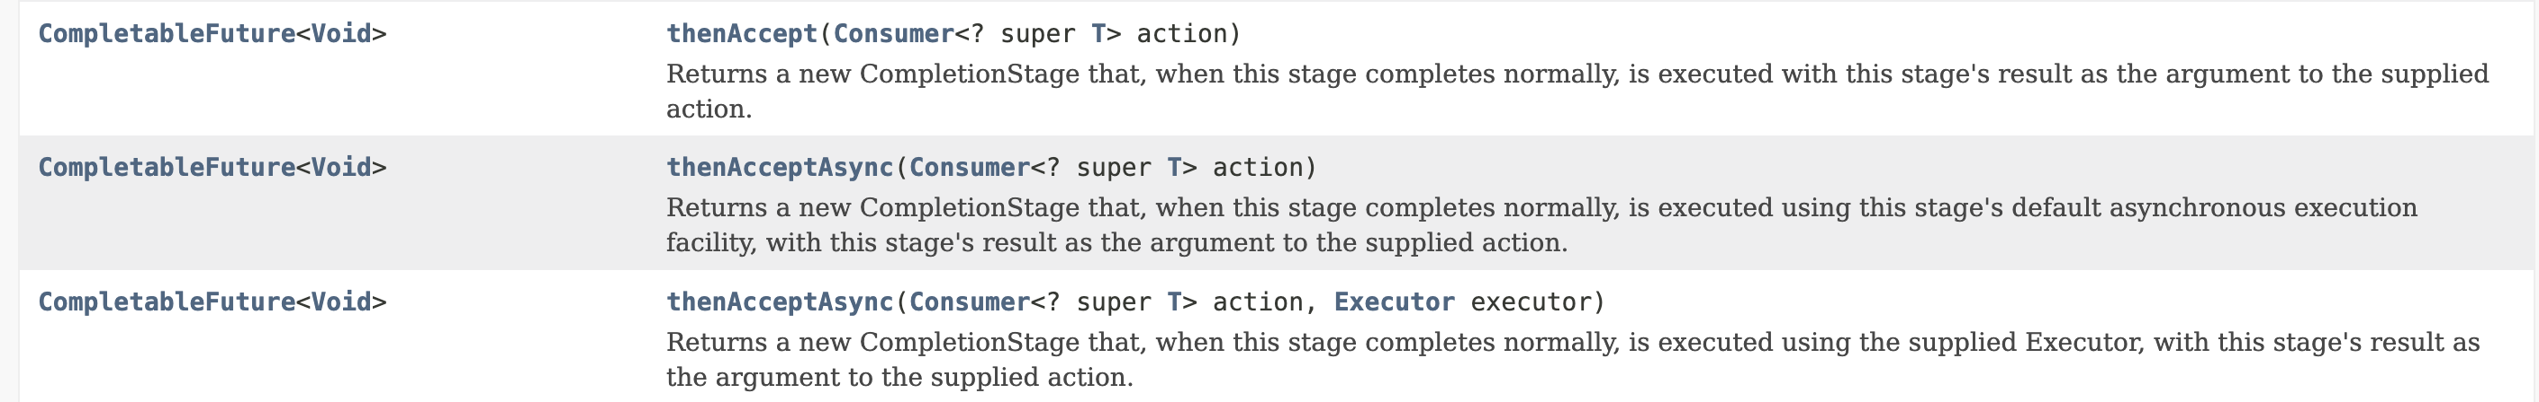
CompletableFuture: thenAccept()
In case of asynchronous execution we can pass through the thread pool of type Executor.
If no Executor is defined, the ForkJoinPool will be used by default in Java, in case this one has more than 2 threads. Otherwise the new thread will be created explicitly for task execution.

Slide 10
CompletableFuture: basic functions
<U> CompletableFuture<U> thenApply (Function<T,U> task)
CompletableFuture<Void> thenRun (Runnable task)
CompletableFuture<Void> thenAccept (Consumer<T> task)
thenApply() gets the result T of the previous step and produces a new output of type U
thenRun() gets a Runnable task for execution (no input, no output)
thenAccept() has input, but doesn’t produce any output
Every of these methods has 3 modifications (e.g. thenRun() and 2 thenRunAsynch())

Slide 11
CompletableFuture: basic functions
thenCompose() works like FlatMap
applyToEither() works with the first result
thenCombine() waits for both results

Slide 12
CompletableFuture: exception handling
No checked exceptions are accepted
If a checked exception occurs in one phase, the chain execution will be terminated and the exception gets lost. The termination will be not announced
Two possibilities:
Handle exception inside of the task
Use error-handle support for CompletableFuture

Slide 13
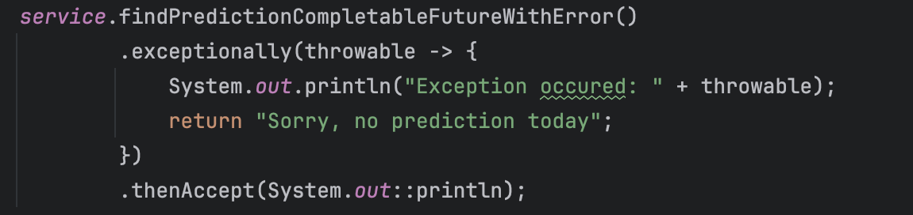
CompletableFuture: exception handling

Slide 14
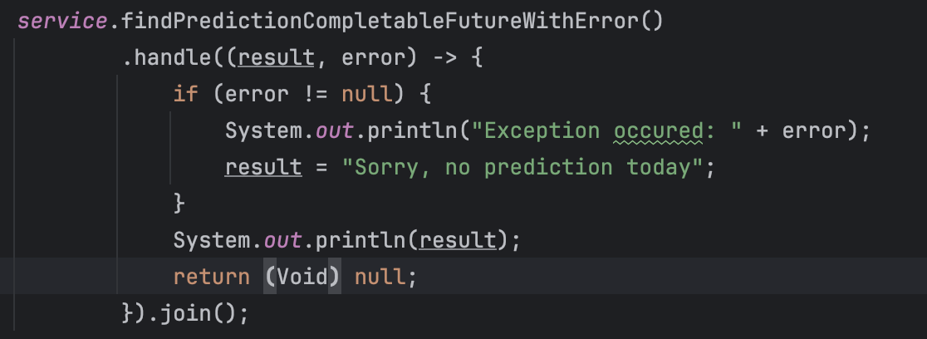
CompletableFuture: exception handling

Slide 15
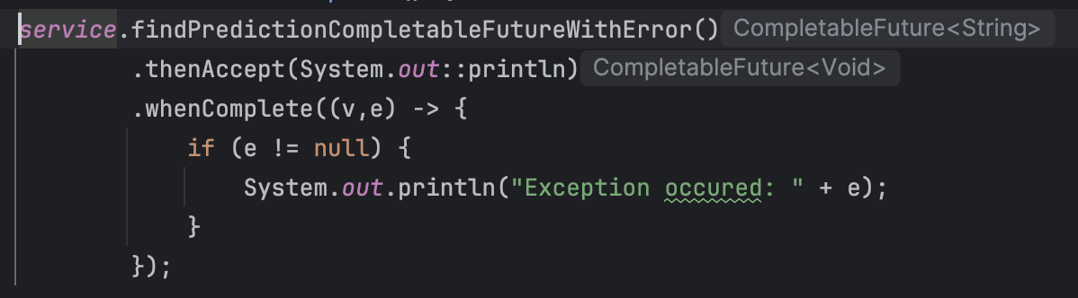
CompletableFuture: exception handling

Slide 16
For more information, check the documentation.

